Slide 1
God’s remedy for anxiety 1. The wisdom of Jesus
Matthew 6:25-34

Slide 2
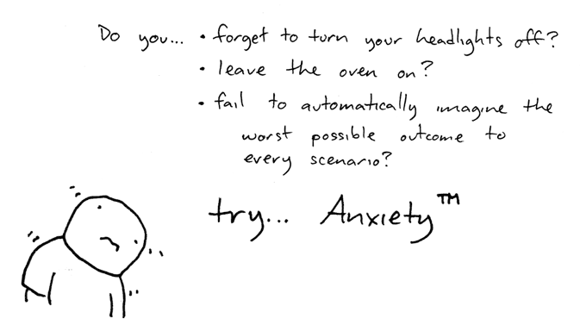
Anxiety - a human condition

Slide 3
Fear, anxiety and worry
Anxiety prepares us for action when we feel threatened in some way
Worry is what we do when we are anxiety is protracted
To become over-anxious is unpleasant, unhelpful and destructive
We can find that worry becomes our automatic response to any challenge in life

Slide 4
Jesus says: Do not worry!
v25 Possible causes
v31 A worried mind
v34 Always future tense

Slide 5
Don’t worry?
There’s no need to
It doesn’t change anything (v27)
It’s counterproductive
It is an expression of unblief

Slide 6
Why not?
You have a heavenly Father (v32)
who knows you, is aware of you, values you, and provides for you
TRUST
You belong to a different kingdom (v33)
with different values
OBEY

Slide 7
How? MEDITATION
Look at the birds (v26)
See how the lilies (v28)
The natural world speaks of the loving care of God
Choose what you think about - take control of your thoughts

Slide 8
How? CONTEMPLATION (v34)
The sacrament of the present moment
Learning to live, not in the past (regret), nor in the future (imagination), but in the present
God’s grace is for TODAY

Slide 9
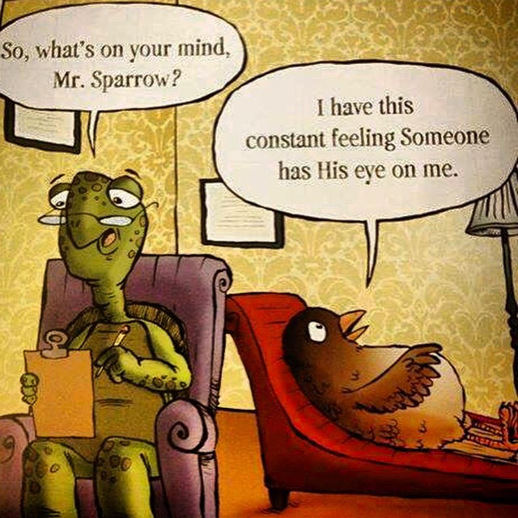

Slide 10
Taking time to be still (Psalm 46:10)
1. Bring yourself into the present moment
2. Allow yourself to rest in the love of God and remind yourself of his Fatherly care.
3. Receive the word spoken to you by God: ‘Do not worry about your life’
4. Hand your cares over to God
5. Thank him for the grip of grace upon your life

Slide 11
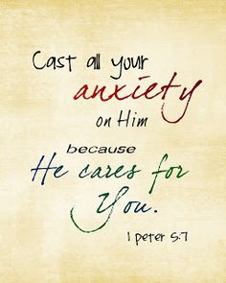
All your anxieties
All your anxieties, all your cares,
Bring to the Mercy Seat, Leave them there;
Never a burden he cannot bear,
Never a Friend like Jesus.

