Slide 1
God’s remedy for anxiety
2. The wisdom of Paul
Philippians 4:6-7

Slide 3
Have no anxiety about anything?
Paul lived a stressful life
He knew anxiety as well: ‘Besides everything else, I face daily the pressure of my concern for all the churches.’ (2Corinthians 11:28)
Anxiety is part of our human experience, but it need not overwhelm us.

Slide 4
A formula for dealing with worry
Prayer + petition + thanksgiving = the peace of God
Peace is our legacy - John 14:27
When Christ was about to leave the world he made his will.
His soul he committed to his Father; his body he bequeathed to Joseph, to be decently interred; his clothes fell to the soldiers; his mother he left to the care of John: but what should he leave to his poor disciples, that had left all for him?
Silver and gold he had none; but he left them that which was infinitely better, his peace. (Matthew Henry)

Slide 5
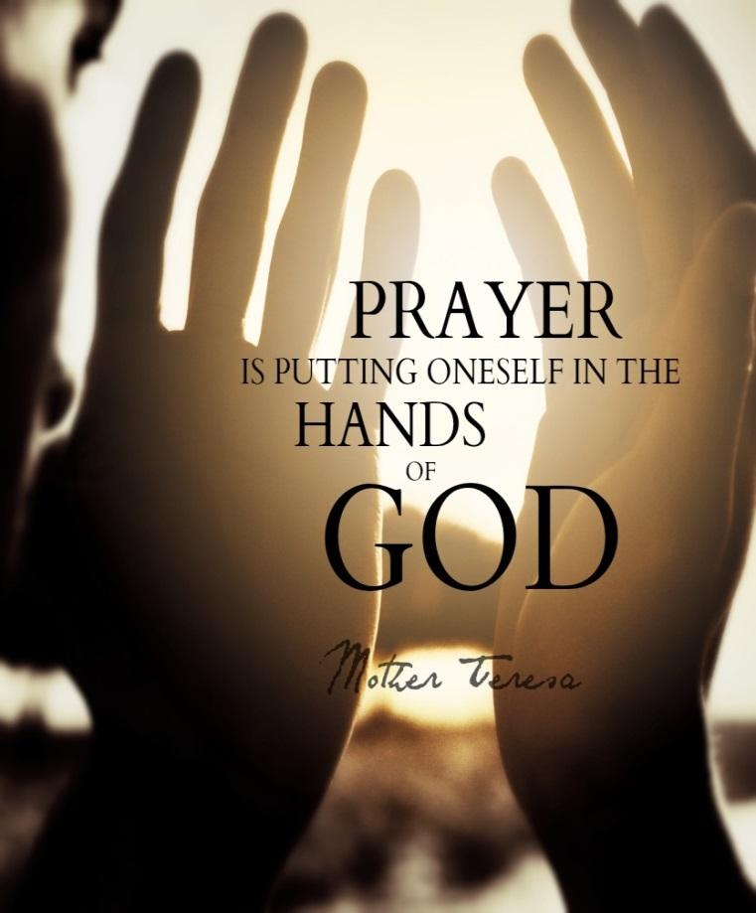
Prayer
Prayer is the language of faith, the method of communication between heaven and earth
The dialogue with self becomes a dialogue with God
Bring God into the picture -‘The Lord is near’ – you are not alone

Slide 6
Petition
Prayer now becomes an earnest appeal for help, a cry to God
‘Hear my prayer, O Lord; let my cry for help come to you. Do not hide your face from me when I am in distress. Turn your ear to me; when I call, answer me.’ Psalm 102:1-2

Slide 7
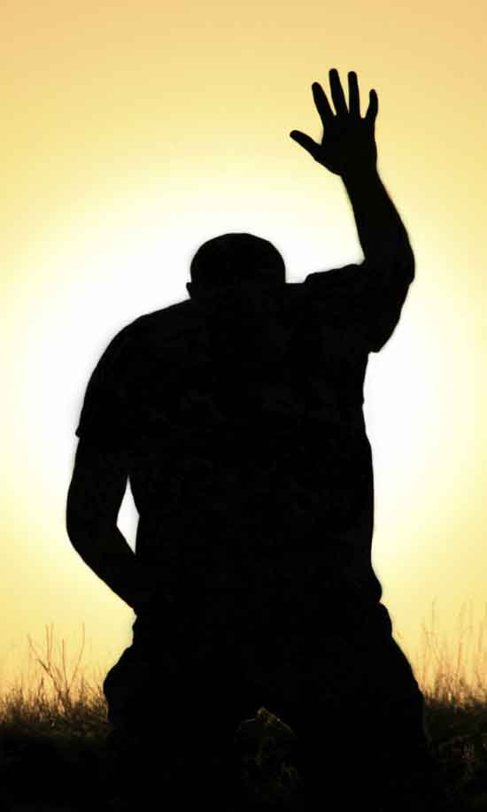
Petition
Present your requests to God
Like the friend at midnight, shamelessly asking for help (Luke 11:5-7)
Like the widow seeking justice, bothering God until there is an answer (Luke 18:1-8)
Perseverance – persistence - patience

Slide 8
With thanksgiving
The crucial ingredient when worry becomes faith
We thank God because: (1) he hears our cry, (2) he knows what is best for us, and (3) he will act when the time is right
When we start to give thanks we are beginning to TRUST.

Slide 9
The peace of God
Peace is restored, it gradually seeps into us again
It will overrule your anxious mind
It will garrison your heart (emotions) and mind (thoughts) from the enemy’s attacks.

Slide 10
The peace of God is always found in Christ Jesus
He who dwells in the shelter of the Most High will rest in the shadow of the Almighty. I will say of the Lord, “He is my refuge and my fortress, my God, in whom I trust.” Psalm 91:1-2

Slide 11
God’s remedy for anxiety
Talk to God
Ask him to help
Thank him in advance
Rest in his peace
There is a battle to be fought

