Slide 1
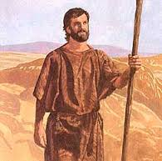
John the Baptist
Preacher of repentance (metanoia)
Luke 3:1-20

Slide 2
Metanoia
The Greek word for ‘repentance’
= a change of mind
= a change of heart
= a change of life
We never outgrow the need for metanoia

Slide 3
The setting
John stands in the overlap between the Old and the New Testaments
His remarkable birth and unusual upbringing prepared him for special calling: to prepare the way for the coming of Jesus
When the time was right he began his ministry, in fulfilment of Isaiah 40:3-5 and Malachi 3:1 and 4:5-6

Slide 4
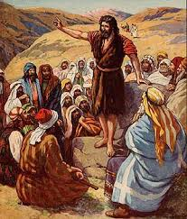
(1) The call to repentance v3
He came ‘preaching a baptism of repentance for the forgiveness of sins’.
Even in the desert, many went out to hear him (Mark 1:5)
It was a time of spiritual revival and renewal

Slide 5
His message
The reality of sin
The need for repentance and confession
The gift of forgiveness
The place of baptism

Slide 6
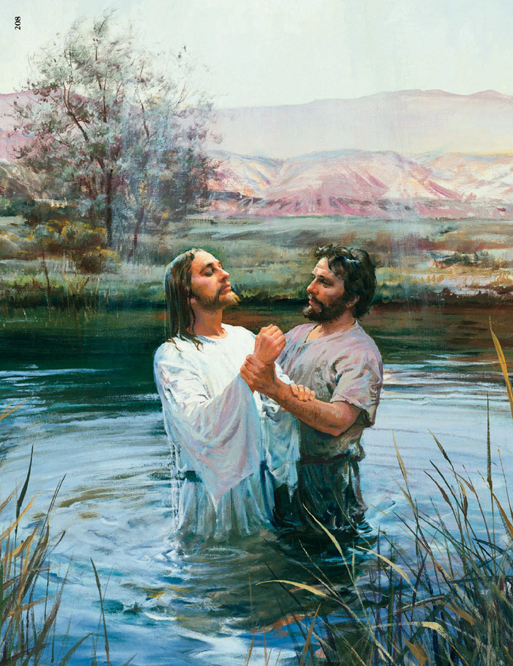
Baptism
Baptism is ‘an outward sign of an inward spiritual grace’
Even Jesus was baptised (Lk 3:21)
It was the custom of the early church (Acts 2:38); ‘repent and be baptised’.

Slide 7
(2) The change in repentance (v8)
Many people were carried along in the emotion of the moment and were not sincere
They still depended on their Jewish ancestry rather than sincerely turning to God in their hearts
Their was no ‘fruit’ or evidence of repentance (metanoia).

Slide 8
What then shall we do?
The rich: be generous (v11)
Tax collectors: be honest (v12-13)
Soldiers: be kind and compassionate (v14)
How has my life changed? How is my life changing? How may I still ned to change?

Slide 9
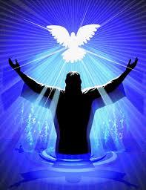
The power to change
John could only do so much
He baptised with water, Jesus baptises with the Holy Spirit and with fire
It is the Spirit who gives us the desire and the ability to change

Slide 10
(3) The challenge of repentance (v19-20)
John was fearless in his call to repentance
Herod enjoyed listening to John, but refused to change (Mark 6:17-20)
In the end, he silenced the prophet’s voice – first by imprisonment, then by execution
No-one is beyond the call of God to repepentance

Slide 11
If you were to have 5 minutes alone with John the Baptist, what might he say to you?

Slide 12
What about me?
‘We all know the boomerang effect of messages, after we have preached the Spirit of God comes and says, “What about you?”’ Oswald Chambers
‘Do not merely listen to the word, and so deceive yourselves. Do what it says.’ James (1:22)

