Slide 1
Living and serving as God’s beloved child
1John 3:1

Slide 2
Are you busy?
Are you busy? Are you very busy? Are you too busy?
When being ‘too busy’ become a way of life our soul suffers
We can be so busy doing things for God we have no time to be with God.
Samson (Judges 16:20)

Slide 3
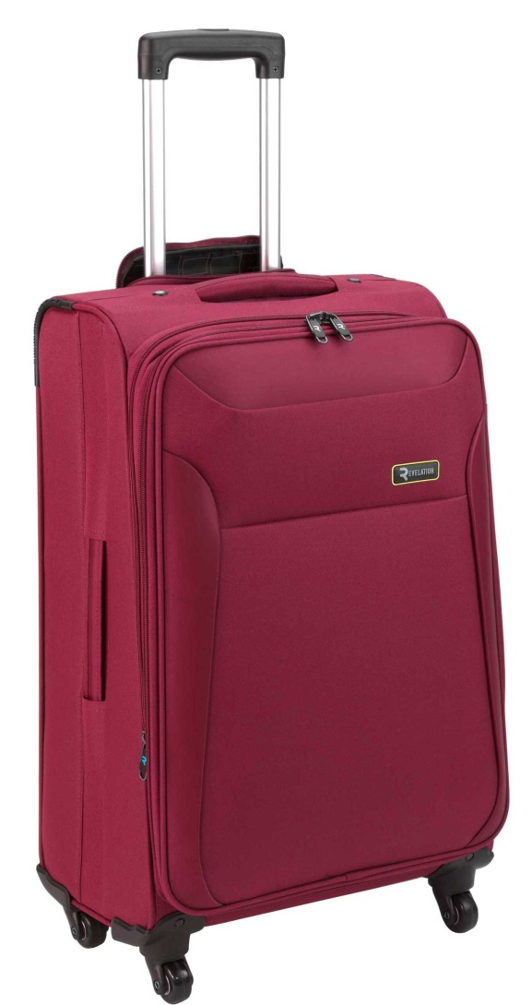
The missing suitcase

Slide 4
1John 3:1
How great is the love the Father has lavished on us,
that we should be called
children of God!
And that is what we are!

Slide 5
You are a child of God
It speaks about relationship, intimacy, knowing, connection, assurance
- through the new birth (John 1:12-13)
- through the process of adoption (Eph 1:5)
Both are true of us.
We can call God ‘Abba, Father’ (Gal 4:6, Rom 8:15)

Slide 6
Have you forgotten who you really are?

Slide 7
You are a deeply loved child of God
You can be a child, yet not be loved
Your heavenly Father loves you not just a little, but a lot!
- ‘great’ (adjective – the nature of God’s love)
- ‘lavished’ (verb – what God does with it)
See Romans 5:5, the work of the Holy Spirit

Slide 8
Let this be your true identity

Slide 9
What difference does it make?
It will make you confident
It will give you compassion
It will help you to change
Take time to dwell in the love of God (John 15:9, Jude v 21)

