Slide 1
Resting in the grip of God’s grace
Romans 8:28-39

Slide 2
1. Our belief
Providence = God is ordering everything that happens in the world so that his purposes come to pass and his will is done
1. The world is under God’s control
2. There is ‘freedom’ and yet God’s purpose and will still come to pass
- Satan
- evil
- sin
- suffering

Slide 3
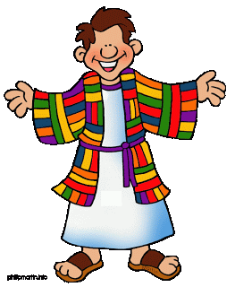
The story of Joseph
God sent me ahead of you to preserve for you a remnant on earth and to save your lives by a great deliverance. So then, it was not you who sent me here but God. Gen 45:7-8
You intended to harm me, but God intended it for good to accomplish what is now being done, the saving of many lives. Gen 50:20

Slide 4
2. Our identity
We are those who love God and are loved by him
The cross demonstrates God’s love (Rom 5:8)
The Spirit reveals God’s love to us (Rom 5:5) and reminds us we are God’s children (Rom 8:15-16)
This is both a comfort and a challenge

Slide 5
3. Our security
We are believers not by accident or chance, or even our own choice, but by the plan and purpose of God
Predestined
Called
Justified
Glorified

Slide 6
4. Our destiny
We have been called according to his purpose
His purpose is that we might become like Christ
God desires that Jesus should be the first of many
He uses the events of our lives to ‘conform’ or shape us.

Slide 7
5. Our assurance
God ‘works’ all things into his good purpose for us
Like a weaver he takes the good and the bad and uses it to produce the likeness of his Son in us.
We may not understand this now, but later we will see his purpose
We are not at the mercy of chance, or evil forces, or even our own mistakes!

Slide 8
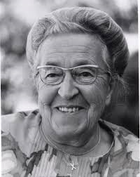
Corrie Ten Boom
I finished speaking and from my bag took a small embroidery. On one side was stitched a beautiful crown. The other side was quite mixed up.
“When I see you on this bed,” I said, “not speaking, not moving, I think of this embroidery.” I held up the back side of the embroidery.
“Your life is like this. See how dark it is. See how the threads are knotted and tangled, mixed up. But when you turn it around then you can see that God is actually weaving a crown for your life. God has a plan for your life and He is working it out in beauty.”

Slide 9
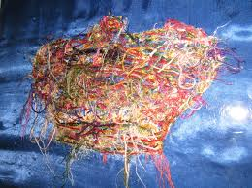
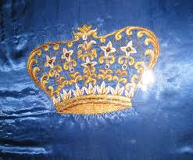
He makes all things beautiful in his time Ecclesiastes 3:11

Slide 10
What then shall we say to this?
How do we respond to the truth?
What we say is vitally important
- to ourselves (self talk)
- to each other (conversation)
- to other people (witness)

Slide 11
1.If God is for us, who can be against us? v31-32
RESOURCES
God is definitely for us!
If he gave his Son for us he will certainly give us everything we need to overcome

Slide 12
2. Who will bring any charge against us? v33-34
STRENGTH
We have been justified, there is no condemnation
Jesus is our great High Priest, praying for us, pouring his grace into our lives every day (Hebrews 4:14-16)

Slide 13
3. Who can separate us from the love of Christ? v35-37
VICTORY
Many things will come against us, but his love is steadfast and his purpose sure
We will overcome, even against the odds

Slide 14
4. I am convinced v38-39
FAITH
Many powers will come against us, but none are equal to the power of Christ in us!
Surrounded by God’s love we can rest safe and secure, knowing he is working everything out for our good!

Slide 15
